Slide 1
Computer Vision (Spring 2019) Problem Set #4
Jijun HU
jijun.hu.0930@gatech.edu
Computer Vision @ GT

Slide 2

1a: Base Shift0 and ShiftR2
ps4-1-a-1
Computer Vision @ GT

Slide 3

1a: Base Shift0 and ShiftR5U5
ps4-1-a-2
Computer Vision @ GT

Slide 4

1b: Base Shift0 and ShiftR10
ps4-1-b-1
Computer Vision @ GT

Slide 5
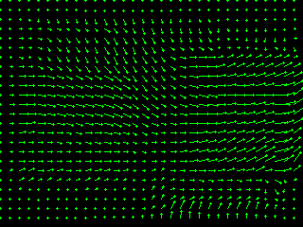
1b: Base Shift0 and ShiftR20
ps4-1-b-2
Computer Vision @ GT

Slide 6

1b: Base Shift0 and ShiftR40
ps4-1-b-3
Computer Vision @ GT

Slide 7
1b: Text Response
Does LK still work? Does it fall apart on any of the pairs? Try using different parameters to get results closer to the ones above. Describe your results and what you tried.
I think LK does NOT work in these cases.
It falls apart for pairs: ShiftR0 vs ShiftR20 and ShiftR0 vs ShiftR40. I tried different parameters for kernel size and also tried to pre process the image ( blurring ), but it still doesn’t work well.
Computer Vision @ GT

Slide 8
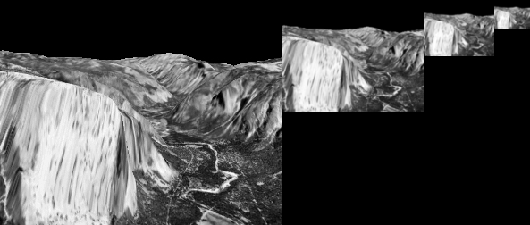
2a: Gaussian Pyramid
ps4-2-a-1
Computer Vision @ GT

Slide 9
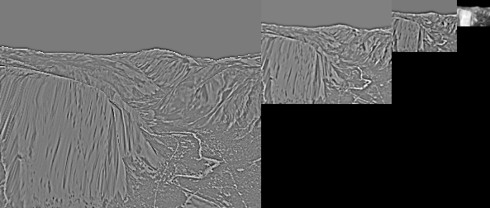
2b: Laplacian Pyramid
ps4-2-b-1
Computer Vision @ GT

Slide 10
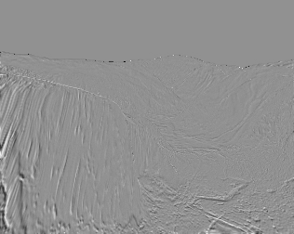
3a: Difference images
ps4-3-a-1
Computer Vision @ GT

Slide 11
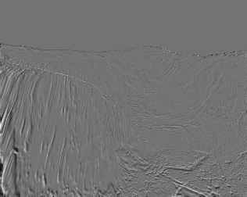
3a: Difference images (cont.)
ps4-3-a-2
Computer Vision @ GT

Slide 12

4a: Hierarchical LK
ps4-4-a-1
Computer Vision @ GT

Slide 13

4a: Hierarchical LK (cont.)
ps4-4-a-2
Computer Vision @ GT

Slide 14

4a: Hierarchical LK (cont.)
ps4-4-a-3
Computer Vision @ GT

Slide 15

4b: Hierarchical LK (cont.)
ps4-4-b-1
Computer Vision @ GT

Slide 16

4b: Hierarchical LK (cont.)
ps4-4-b-2
Computer Vision @ GT

Slide 17
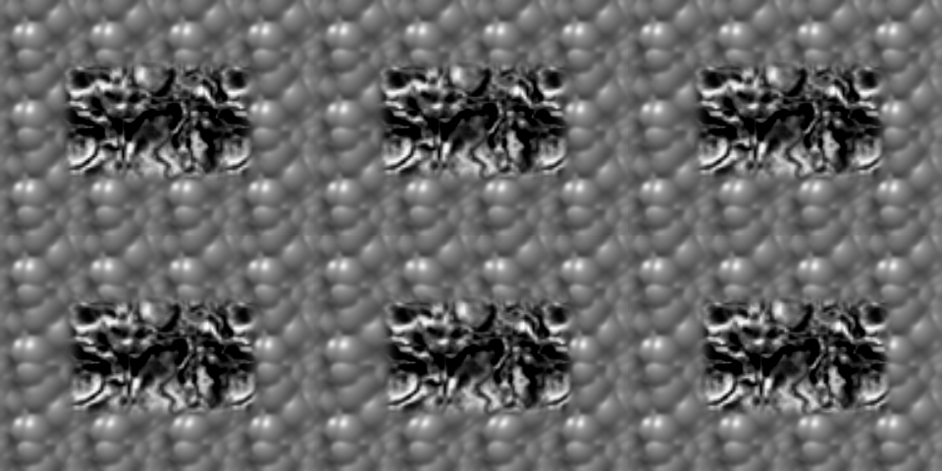
5a: Frame Interpolation
ps4-5-a-1
Computer Vision @ GT

Slide 18
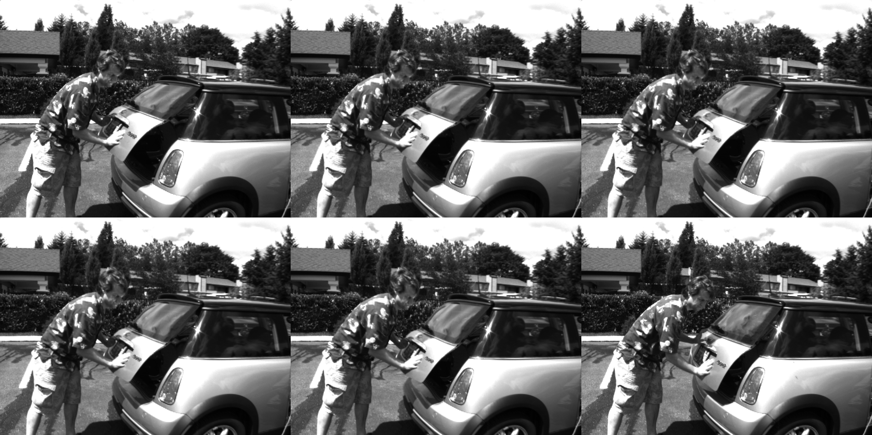
5b: Frame Interpolation
ps4-5-b-1
Computer Vision @ GT

Slide 19
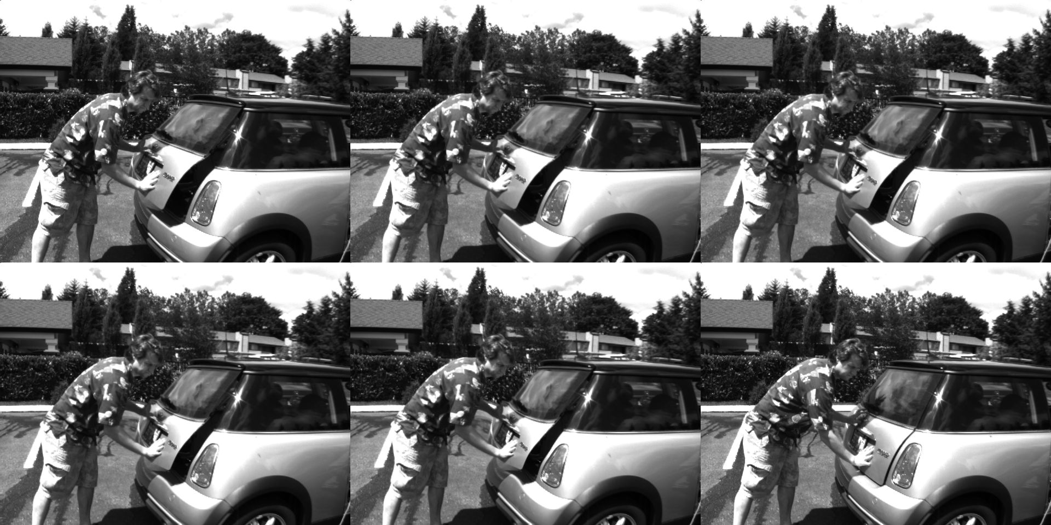
5b: Frame Interpolation
ps4-5-b-2
Computer Vision @ GT

Slide 20

6: Challenge Problem
ps4-6-a-1
Computer Vision @ GT

Slide 21

6: Challenge Problem (cont.)
ps4-6-a-2
Computer Vision @ GT

Slide 22
6: Challenge Problem (cont.)
Video link:
https://www.dropbox.com/s/0sw8rivo53lfufm/ps4-6-video.mp4?dl=0
Computer Vision @ GT

